Slide 1
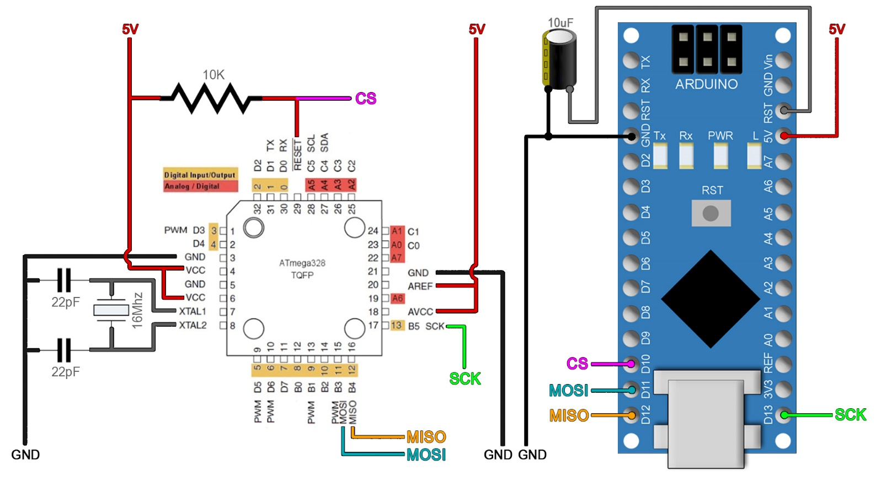
Programming steps
Burn the bootloader
First, below you have the general connections for the ATmega328p-AU with the basic configuration.
Then, later you will have connections to the PCB. But just in case, if you have a different PCB,
make sure you have the connections below before you try burning the bootloader.
Circuit connection

Slide 2
Arduino as ISP
Ok, we have to burn a bootloader to the chip and then upload our codes. For these steps
we need the connections above to an Arduino. In my case I will use Arduino NANO because I
have the AU version of the chip. So, make the connections as above between the Arduino SPI
port and the PCB. We will use the Arduino as ISP to upload codes. In order to use the Arduino as an ISP programmer, we need to upload a code to it
so for that, go to Examples -> ArduinoISP -> ArduinoISP and open that example code.
Then make sure you elect the type of board for your Arduino, in my case, Arduino NANO.
Select the com and leave the default programmer as "AVRISP mkII". Connect the USB,
select the COM and upload the code to the Arduino UNO.

Slide 3
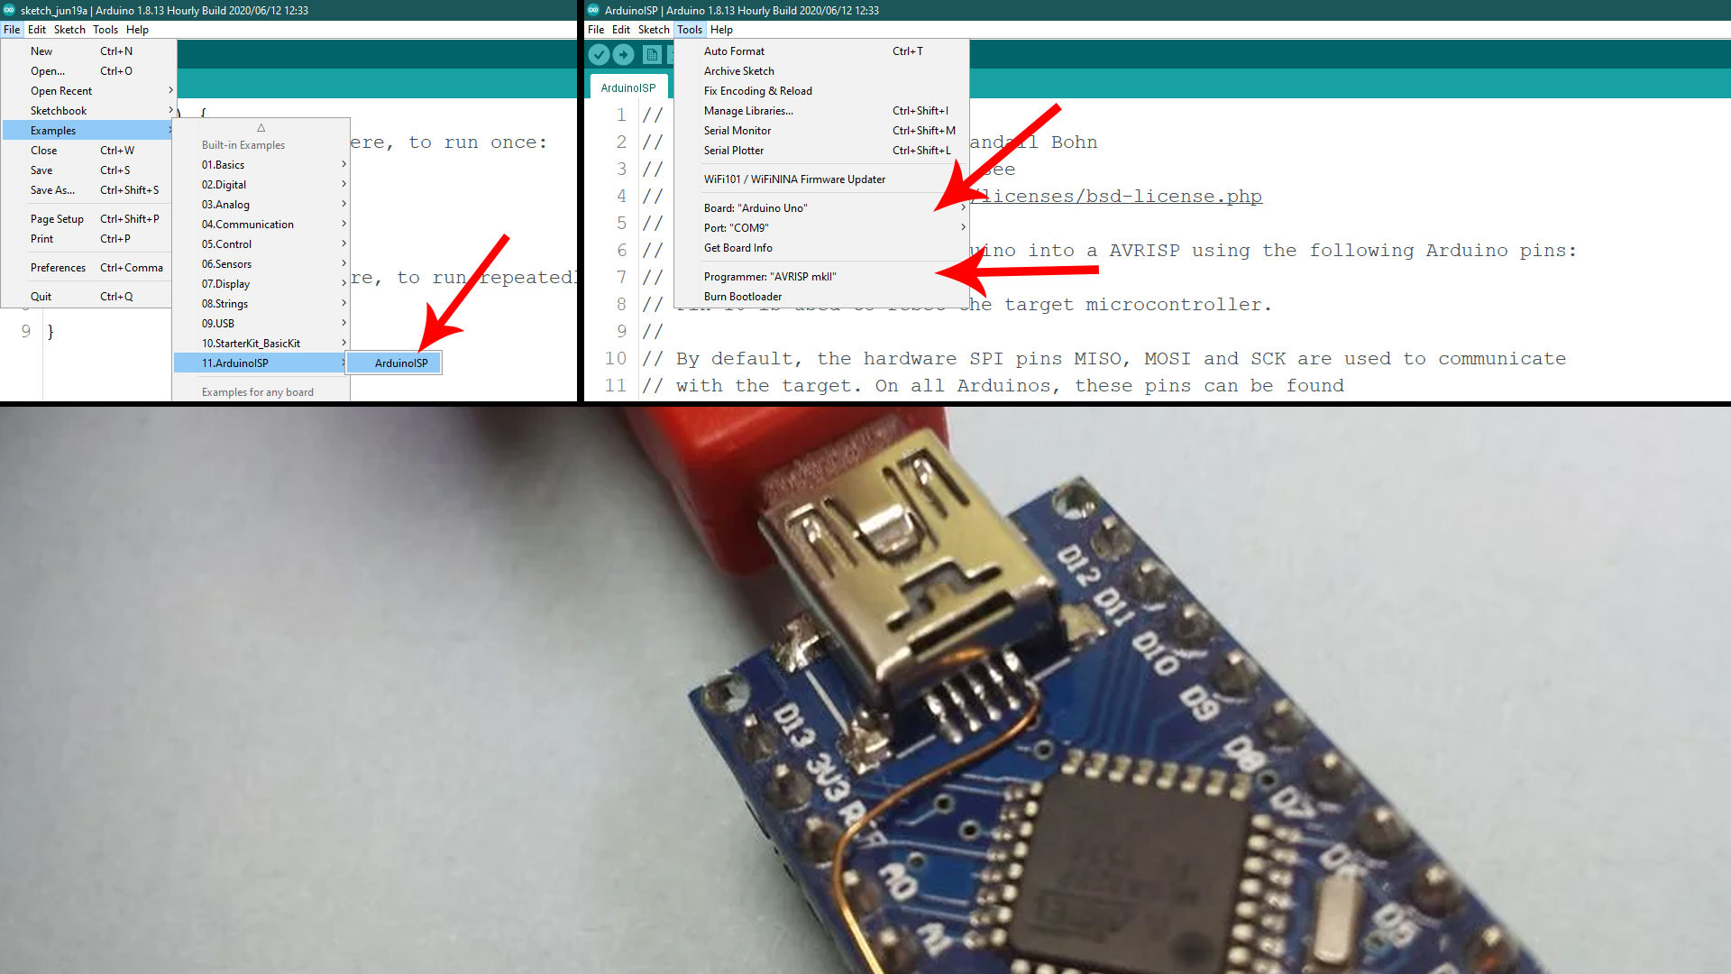

Slide 4
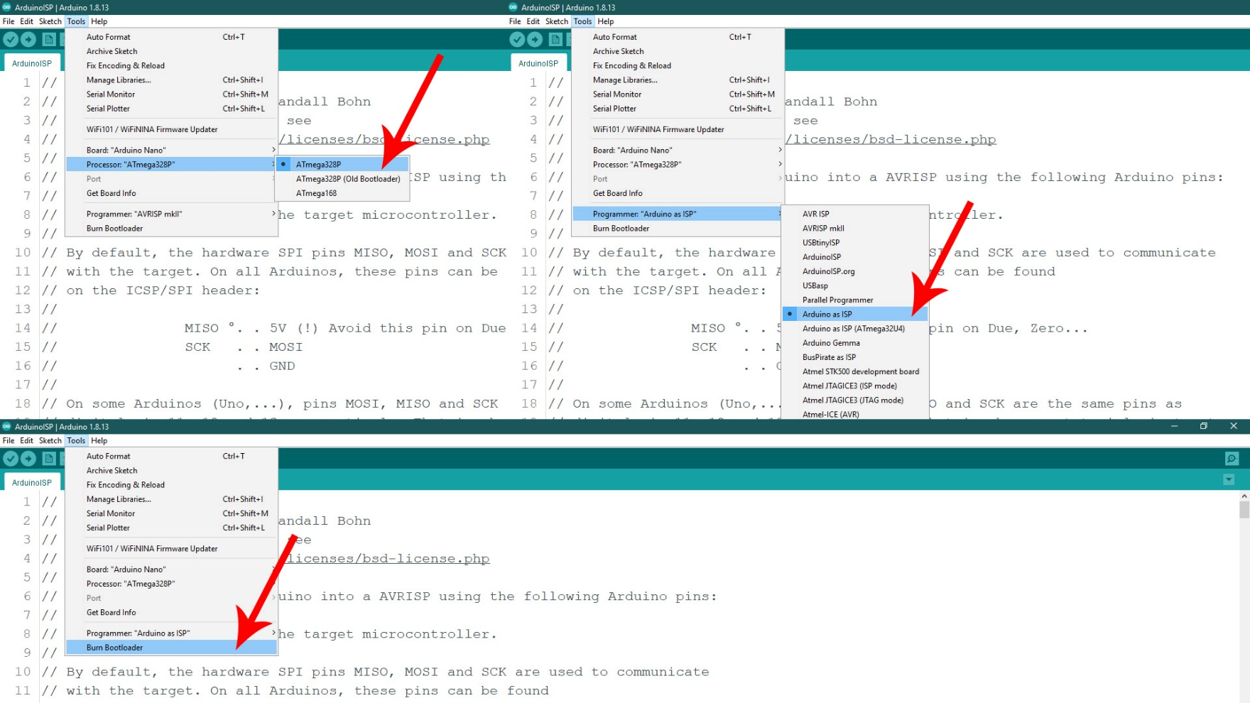
Bootloader burn
Ok, now the Arduino has the ISP code so it will act as a ISP programmer. Now, let's burn the bootloader.
Go to Tools -> Board and select the NANO type of board. Go to Tools -> Programmer and make sure
you now change the normal programmer from "AVRISP mkII" to "Arduino as ISP". Finally, make sure the
Arduino NANO is connected to the PCB to the ISP port and go to Tools -> Burn Bootloader. The Arduino
Rx/Tx LEDs will blink and after a while you will get the bootloader burn complete on the screen.

Slide 5
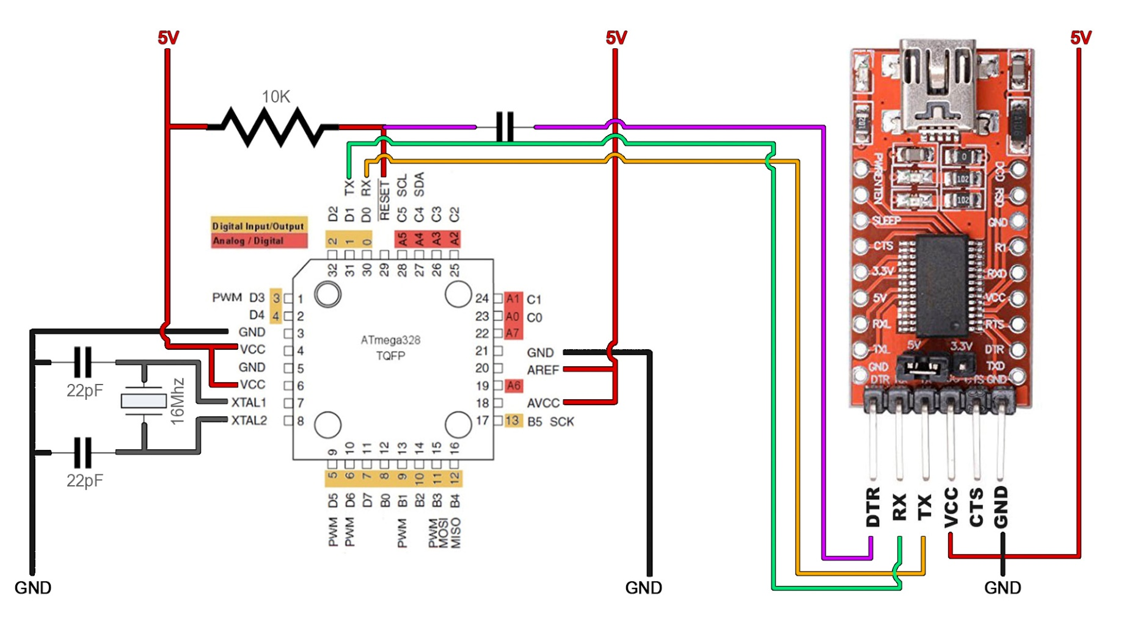
Uploading Slave codes
Make sure that you change back the programmer from "Arduino as ISP" to "AVRISP mkII".
Then connect the FTDI programmer to the U
ART port as below to pins RX, TX and DTR.
Add a 100nF cap between DTR and reset pin of the chip. Make sure you have selected Arduino NANO
as board and the COM of the FTDI programmer. Then, get your code, compile and uplaod.

Slide 6
To upload slave code
Make sure that you change back the programmer from "Arduino as ISP" to "AVRISP mkII". Then connect the FTDI programmer to the UART port of the PCB as below to pins RX, TX and DTR. The PCB already has the 100nF capacitor so don't worry. Make sure you have selected Arduino NANO as board and the COM of the FTDI programmer. Then, get your code, compile and upload.

Slide 7
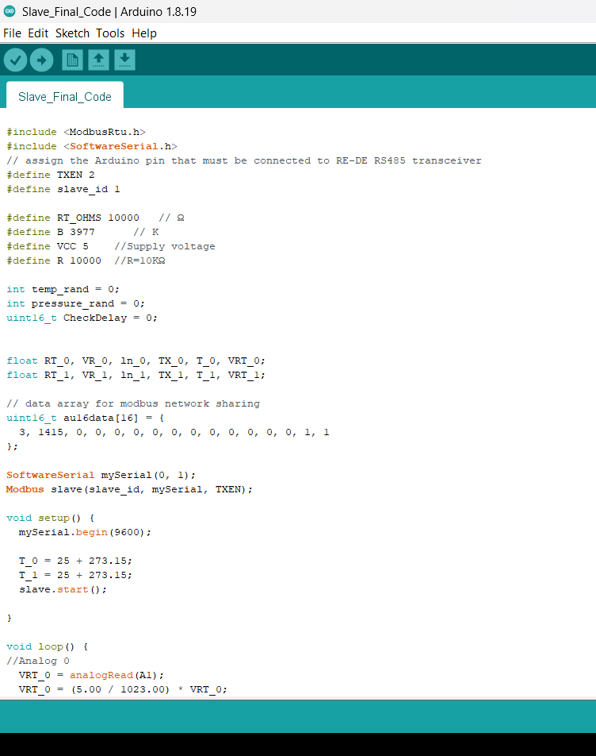
Slave Code
Note:- for Slave 1-2-3-4-5 ----- 25 we need to change the slaves id as shown in the screenshot

Slide 8
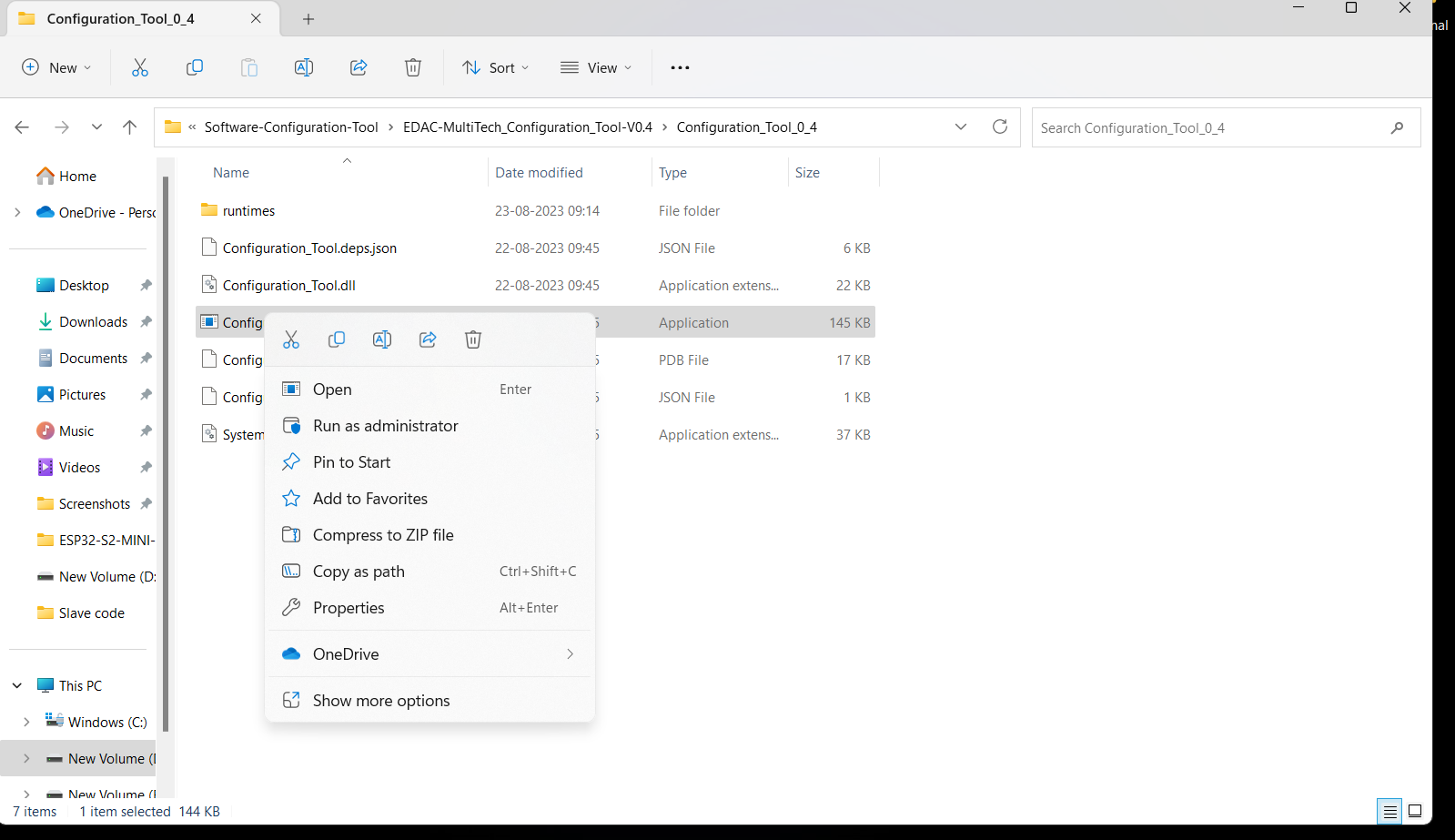
RTC Time Setting using Window UI
Connect the hardware to laptop or pc
Right click on configuration & click on run as administration

Slide 9
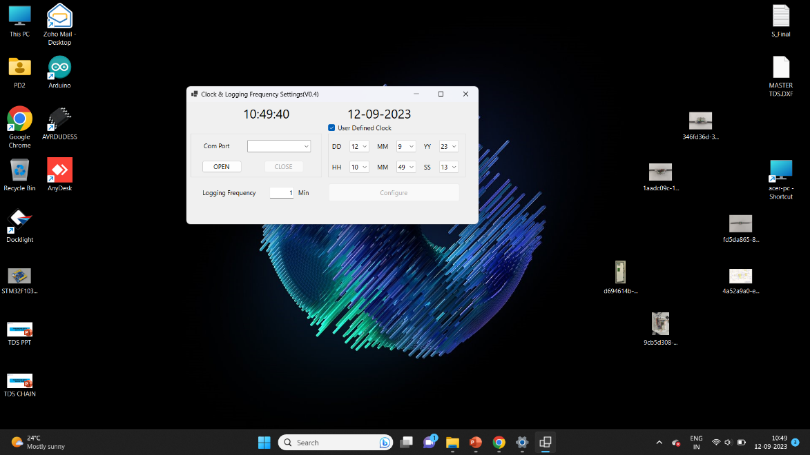
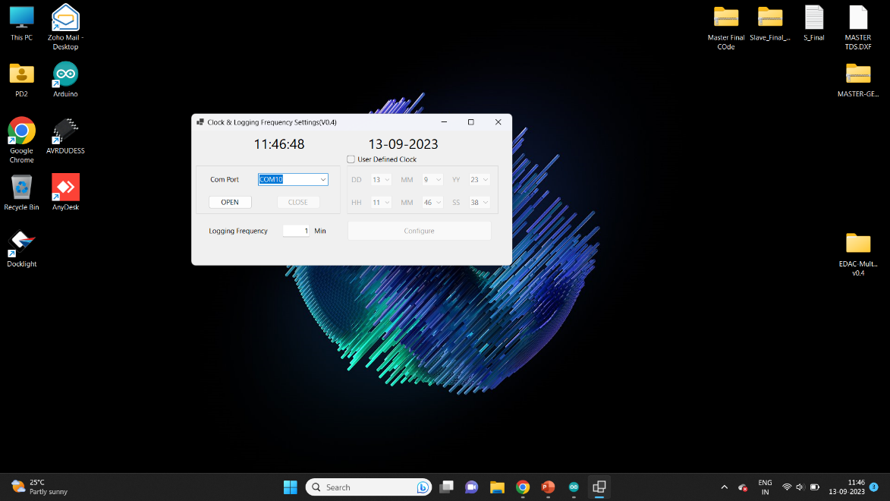
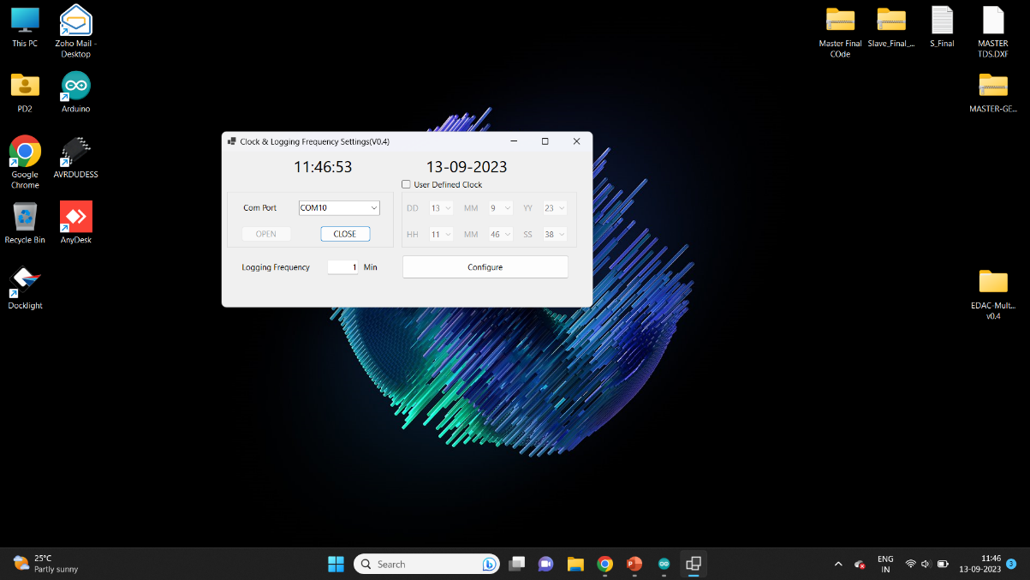
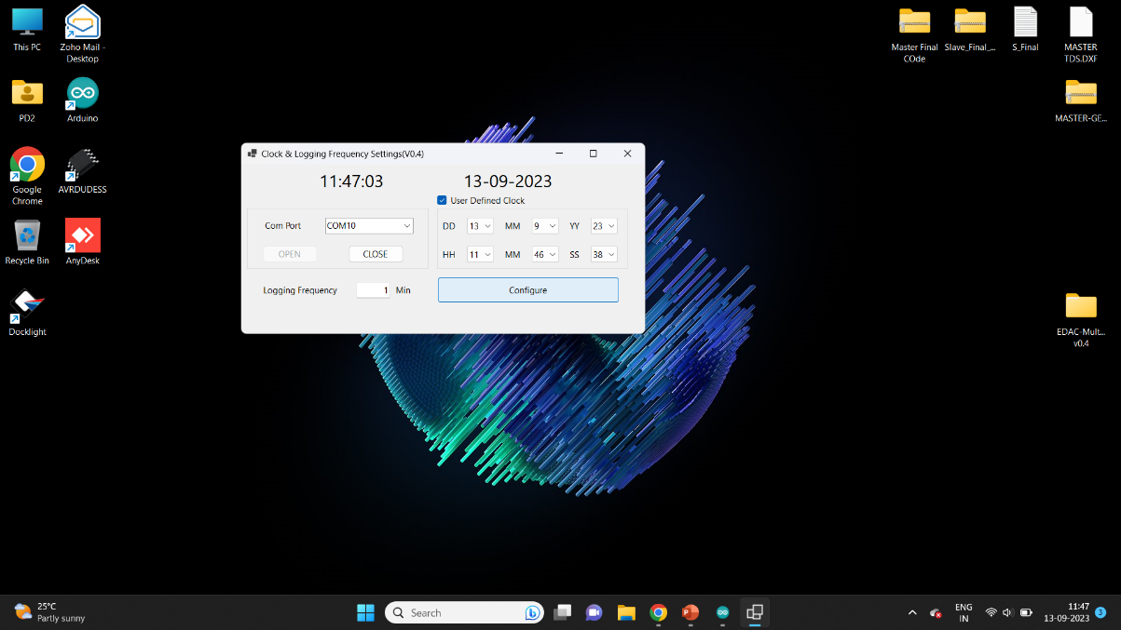
Select Com Port
Press on open
Set logging frequency
Select the User defined Clock & press or click on configure

Slide 10
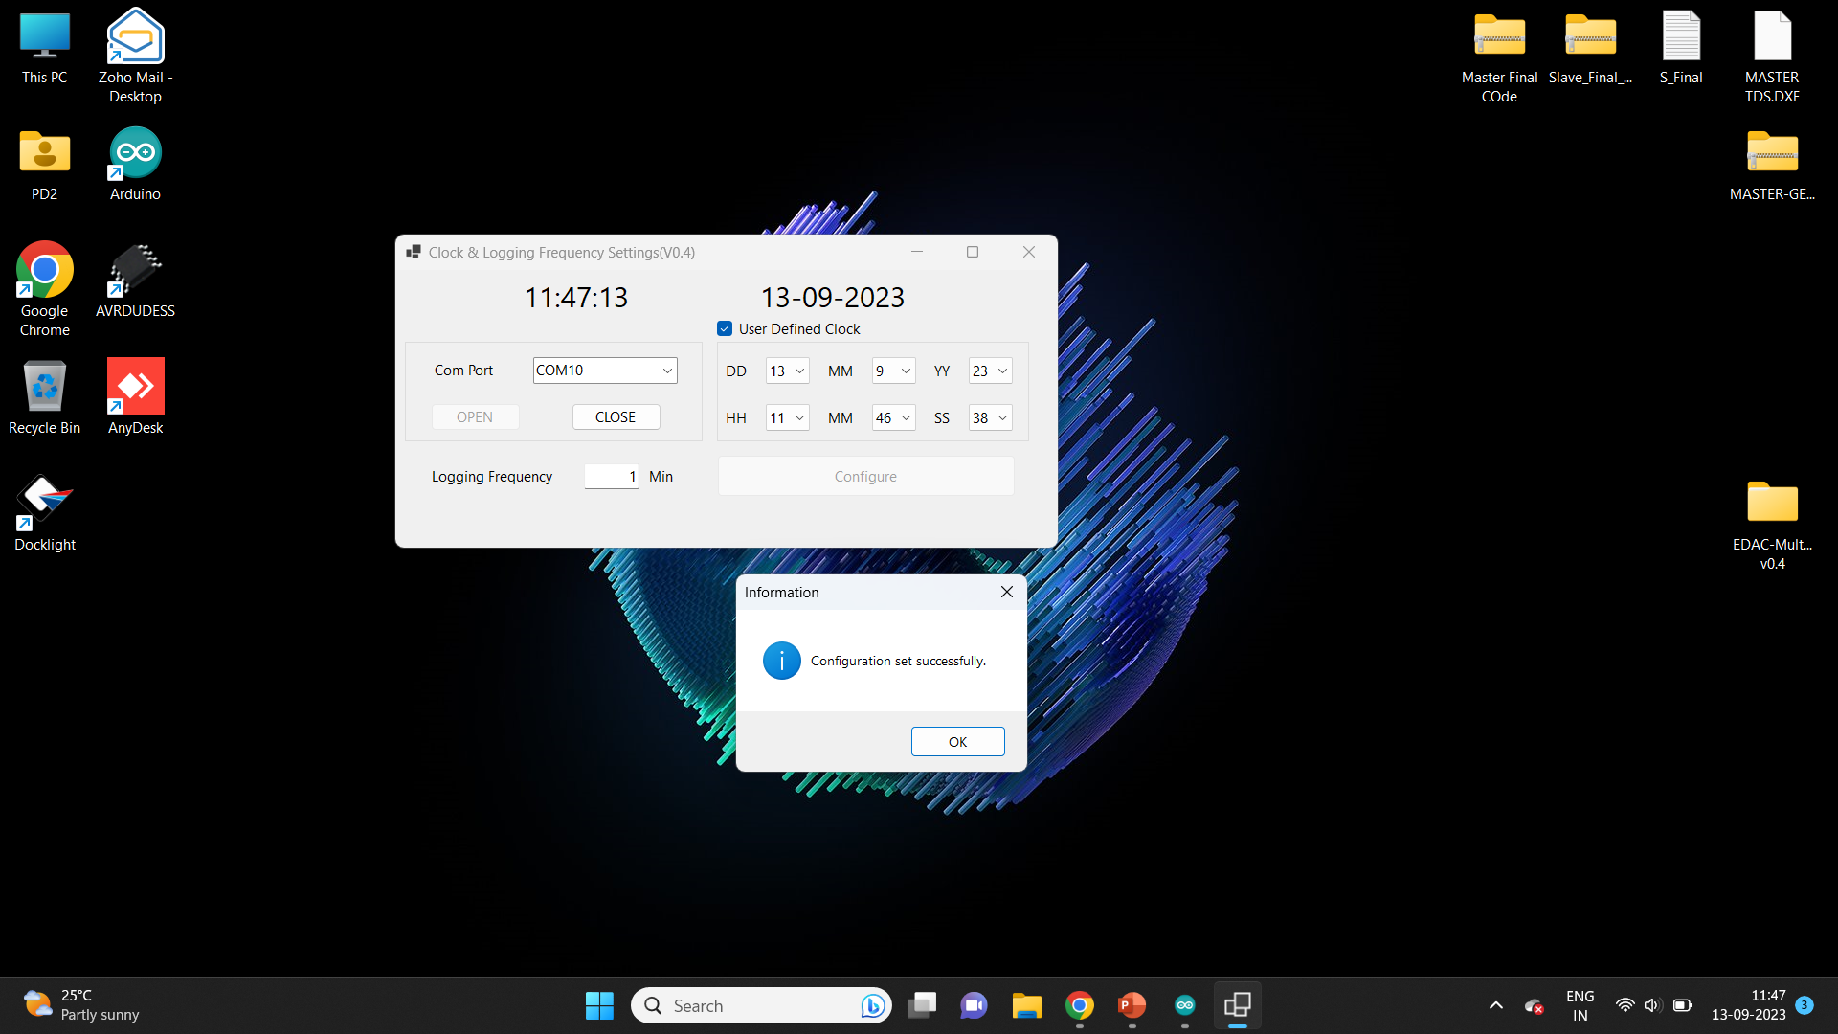
Information display popup now device is configuration set successfully

